Slide 1
43 Million

Slide 2
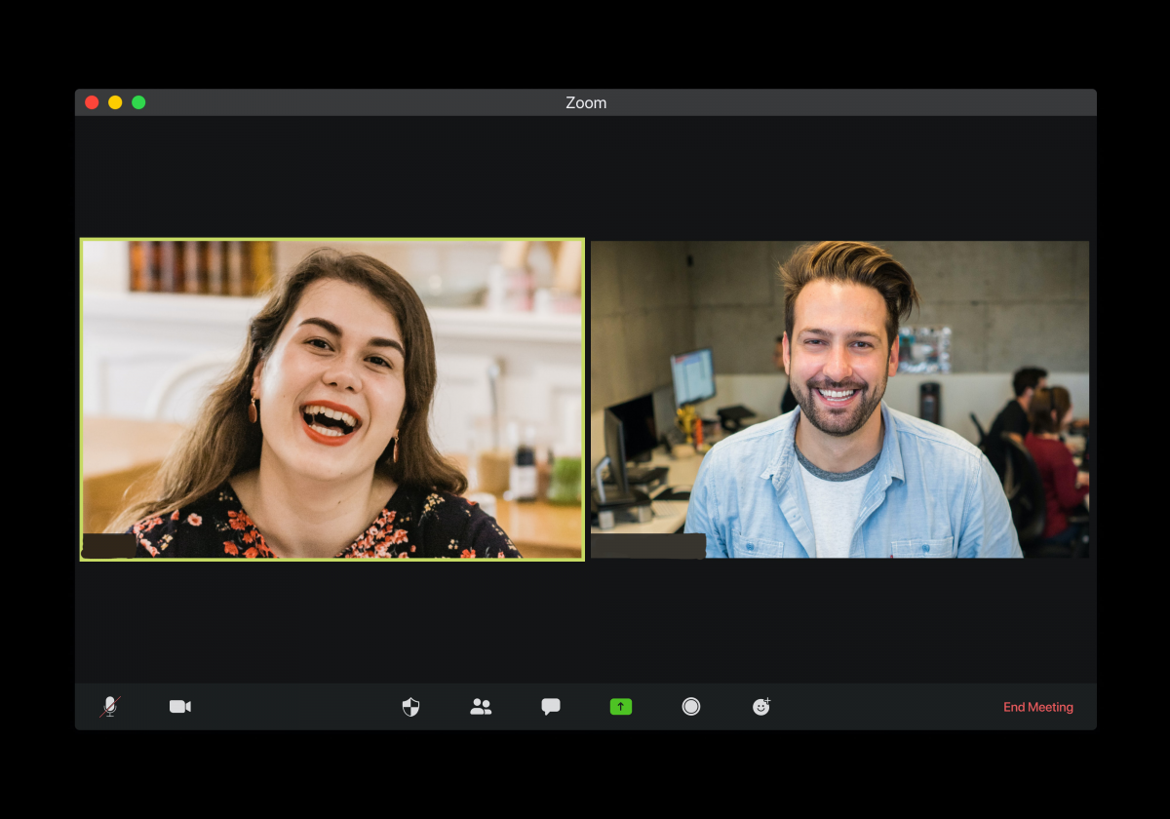

Slide 3
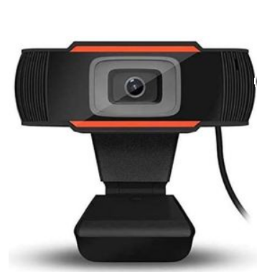

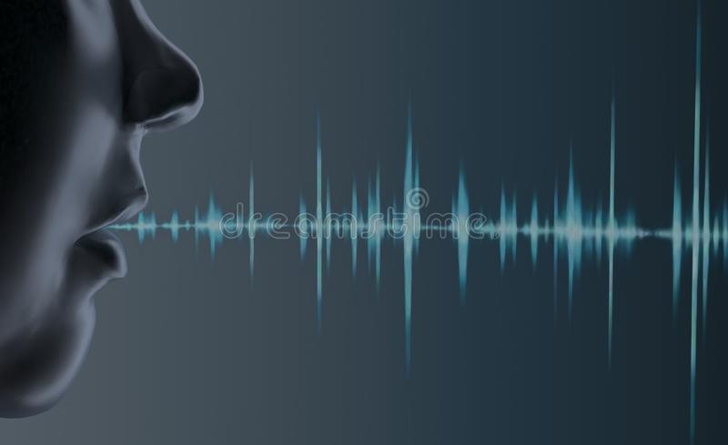
Tune Camera

Slide 4
Demo

Slide 5
Who are We
Math and Computer Science students.

